Slide 1
IN THE NAME OF GOD

Slide 2
Hypophysitis:
An update on the novel forms, diagnosis and management of disorders of pituitary inflammation

Slide 3
Article used:
Hypophysitis: An update on the novel forms, diagnosis and management of disorders of pituitary inflammation.( Best Practice & Research Clinical Endocrinology & Metabolism YBEEM 2019.101371)
Hypophysitis – diagnosis and treatment ( European Journal of Endocrinology 2018 as Manuscript EJE-17-0009)

Slide 4
AGENDA:
Introduction
Classification of hypophysitis
Novel causes of secondary hypophysitis
Clinical features of hypophysitis
Diagnosis of hypophysitis
Treatment of hypophysitis
Summary: Challenges and Future directions
Practice Points

Slide 5
Introduction:
Hypophysitis is the general term used to describe any form of sellar and/or suprasellar inflammation that leads to structural changes in the hypothalamic-pituitary axis and varying degrees of anterior and/or posterior pituitary hormonal deficiencies .
Clinically, the presentation of hypophysitis can range from an asymptomatic disease to a rapidly progressive disease potentially with fatal consequences.
Based on several reports, the estimated overall prevalence of hypophysitis has ranged from 0.2% to 0.88% .
Best Practice & Research Clinical Endocrinology & Metabolism YBEEM 2019.101371

Slide 6
The number of hypophysitis cases is likely to increase in the upcoming years due to several factors:
An increase in the knowledge and awareness of the condition among physicians
Higher numbers of pituitary imaging and surgeries
The rise in the number of certain forms of hypophysitis such as ICIHy
Novel forms of hypophysitis called anti-pituitary-specific transcription factor-1 hypophysitis (anti-PIT1Hy) and isolated adrenocorticotropic hormone (ACTH) deficiency have been recently identified

Slide 7
AGENDA:
Introduction
Classification of hypophysitis
Novel causes of secondary hypophysitis
Clinical features of hypophysitis
Diagnosis of hypophysitis
Treatment of hypophysitis
Summary: Challenges and Future directions
Practice Points

Slide 8
Classification of hypophysitis:
Primary hypophysitis (PHy)
Secondary hypophysitis (SHy)
Best Practice & Research Clinical Endocrinology & Metabolism YBEEM 2019.101371

Slide 9

Primary hypophysitis
Secondary hypophysitis
1. Lymphocytic hypophysitis (LHy)
2. Granulomatous hypophysitis (GHy)
3. IgG-4 hypophysitis (IgG4Hy)
4. Xanthomatous hypophysitis (XHy)
5. Necrotizing hypophysitis (NHy)
6. Mixed forms (lymphogranulomatous, xanthogranulomatous hypophysitis)
1. Autoimmune endocrinopathies
2. Systemic autoimmune diseases
3. Vasculitides
4. Inflammatory and proliferative disorders
5. Neoplastic lesions of the sellar and suprasellar regions
6. Drug-induced hypophysitis
7. Infections
8. Paraneoplastic syndromes

Slide 10
Autoimmune hypophysitis (AHy)
Results from autoimmunity-mediated destruction of the pituitary gland
AHy includes most forms of hypophysitis under PHy category
Those secondary to autoimmune polyendocrinopathies and systemic autoimmune diseases under SHy

Slide 11
Hypophysitis can also be classified based on the anatomical site of pituitary gland involvement:
Only the anterior pituitary (adenohypophysitis)
Posterior pituitary (infundibulo neurohypophysitis)
Entire pituitary gland (panhypophysitis)
Best Practice & Research Clinical Endocrinology & Metabolism YBEEM 2019.101371

Slide 13
Lymphocytic hypophysitis
• Most common form of hypophysitis (68% of PHy)
• Histopathology: lymphocytic infiltration in the interstitium and in the pituitary acini. Lymphoid follicles with germinal centers can be observed
Best Practice & Research Clinical Endocrinology & Metabolism YBEEM 2019.101371

Slide 14
LHy
LAHy
female:male ratio = 4:1
associated with late pregnancy or the postpartum period,
LINHy
female:male ratio = 1:1
female:male ratio = 1.9:1
LPAHy
mean age of presentation is 39 ± 20 years
younger age for women (35 ± 13 years) as compared to men (49 ± 16 years).
mean age of presentation is 43 ± 17 years

Slide 15
Several pituitary antibodies directed against various antigens have been described: GH, alpha enolase , somatotroph, lactotroph, gonadotroph, and corticotroph cells
Causing selective hormonal deficiencies
However, the pathogenicity of these antibodies is not yet well-established.
Several HLA alleles are associated with LHy, including HLA DQ8, DR4, DR5, and DR53 .
Further research is required to establish a more definitive association between HLA and LHy pathogenesis.

Slide 16
While several autoimmune conditions improve during pregnancy, LHy paradoxically manifests during pregnancy:
Increase in pituitary antigens secondary to the pituitary hyperplasia that occurs during pregnancy,
Change in the hypophyseal blood flow pattern in which the pituitary derives more blood supply from the systemic circulation than from the hypothalamic-hypophyseal portal system, thus increasing exposure to the immune system
Molecular mimicry through co-expression of antigens such as enolase isoforms in both pituitary and placenta, which are known targets of certain pituitary antibodies, can also possibly explain the increased frequency of LHy during pregnancy

Slide 17
Granulomatous hypophysitis
  • Second most common form (20% of PHy)
  • Common in females (female:male = 2.6:1)
  • Mean age of presentation: 44 years
  • Might represent a later stage in the course of natural history of LHy
• However,unlike LHy, GHy does not seem to bear a strong association with pregnancy and peri-partum period
Best Practice & Research Clinical Endocrinology & Metabolism YBEEM 2019.101371

Slide 18
Several granulomatous conditions that cause Shy:
tuberculosis, sarcoidosis, vasculitides such as granulomatosis with polyangitis, Langerhan’shistiocytosis, syphilis,
these conditions causing Shy, should be ruled out
Best Practice & Research Clinical Endocrinology & Metabolism YBEEM 2019.101371

Slide 19
IgG-4 hypophysitis
Prevalence of 4% among PHy
Often part of a systemic disease known as IgG4 disease (autoimmune pancreatitis, Riedel’s thyroiditis, retroperitoneal fibrosis, inflammatory pseudotumor)
More common in males in cases of systemic involvement (female:male =1:3), but isolated hypophysitis is more common in females (female:male = 2:1)
Mean age of presentation is earlier in females (females: 56.4 years; males: 67.5 years)
Best Practice & Research Clinical Endocrinology & Metabolism YBEEM 2019.101371

Slide 20
More common in eastern countries such as Japan
Histopathology: mononuclear infiltration with ≥10 IgG4 positive plasma cells per high power field, storiform fibrosis, rarely lymphoid follicles and eosinophils
Highly responsive to glucocorticoid therapy

Slide 21
Diagnosis can be established based on the following criteria:
1. Histopathological evidence on pituitary biopsy
2. Hypophysitis on MRI
3. Biopsy-proven systemic involvement
4. Serum IgG4 levels >140 mg/dl
5. Excellent response to glucocorticoid therapy
Criterion 1 alone, or criteria 2 +3 , or criteria 2 + 4 + 5 establish the diagnosis

Slide 22
Xanthomatous hypophysitis
• Prevalence of about 3% among PHy
• More common in females (female:male = 3:1)
• Commonly presents in the 4th decade
• Usually causes adenohypophysitis, Central DI is uncommon
• Histopathology: infiltration with CD68 positive foamy macrophages
• MRI can show cystic areas of liquefaction
• Visual symptoms are uncommon in this type of hypophysitis
• Precise aetiology unclear: likely an inflammatory reaction to a ruptured Rathke’s cleft cyst

Slide 23
Secondary causes such as Erdheim-Chester disease can also give rise to xanthomatous or xanthogranulomatous lesions in the pituitary and must be suspected in supposed XHy cases with multi-organ involvement, especially if these lesions harbor the somatic BRAF V600E variant
Erdheim-Chester disease is a rare type of slow-growing blood cancer called a histiocytic neoplasm, which results in overproduction of cells called histiocytes.
Bone pain,Retroperitoneal fibrosis,Diabetes insipidus,Exophthalmos,Xanthomas Neurological signs (including ataxia),Dyspnea caused by interlobular septal and pleural thickening,Kidney failure,Hypopituitarism,Liver failure

Slide 24
Necrotizing and mixed forms of hypophysitis
The rarest form of PHy (0.6%)
Females are more commonly affected than males (3:1)
Although the disease could be a separate entity altogether, it is more likely that NHy represent a more severe form of one of the other forms of hypophysitis
NHy can also occur with SHy
present more acutely with mass effect symptoms (e.g., eye pain, visual defects) or even as aseptic meningitis.
Best Practice & Research Clinical Endocrinology & Metabolism YBEEM 2019.101371

Slide 25
Other conditions that can cause pituitary necrosis include Sheehan syndrome, macroadenomas, pituitary metastases, septic shock, and snake venom poisoning, and must be considered in the differential diagnoses .

Slide 26
Mixed forms of hypophysitis
4% of PHy cases
Lymphogranulomatous features of both LHy and GHy, but it is likely that this subset of hypophysitis histopathologically could represent a transition from an initial lymphocytic infiltrative pattern of LHy to a more granulomatous, chronic inflammatory pattern of GHy
Xanthogranulomatous (XGHy) containing both foamy xanthoma cells and multinucleated giant cells . appear to represent a disease spectrum, with XHy being the earlier manifestation followed by XGHy changes that occur later during the course of the disease.
Best Practice & Research Clinical Endocrinology & Metabolism YBEEM 2019.101371

Slide 27
Secondary hypophysitis
Immune checkpoint inhibitor induced Hypophysitis
ICI therapy has revolutionized the field of oncology, and their treatment indications are being increasingly investigated in several forms of cancers.
At least seven ICIs are currently approved by the FDA (ipilimumab, nivolumab…)
ICI therapy reactivates the T cells and enhances detection of cancer cells, leading to immune-mediated tumor lysis

Slide 28
Immune checkpoint inhibitors (ICIs) are monoclonal antibodies that target the immune checkpoints (CTLA4, PD1/PDL1) and inhibit their action, leading to persistent TLC activation and proliferation. This up-regulation in TLC activity caused by ICIs leads to destruction of the tumor and, as an adverse effect, also causes ICIH and other immune-related adverse events.

Slide 29
Aim: This study aims to determine the incidence of all immune-mediated adverse events (IMAEs) with a focus on hypophysitis in patients with metastatic melanoma receiving immune checkpoint inhibitors (ICI).
Methods: 51 patients with metastatic melanoma who received immune checkpoint inhibitors (ipilimumab,pembrolizumab and nivolumab) in Ninewells Hospital, Dundee between 2014 and 2018 were identified. Patient demographic data and outcomes were recorded retrospectively.
Melanoma Manag. (2019) 6(1), MMT13

Slide 30
Melanoma Manag. (2019) 6(1), MMT13

Slide 31
Melanoma Manag. (2019) 6(1), MMT13

Slide 32
Figure 3. Kaplan–Meier survival curve comparing overall survival of patients affected by immune-mediated adverse
reaction versus those who did not
(p = 0.030).
A significant improvement in overall survival (p = 0.03) was seen in patients who developed IMAEs compared with those who did not.
Melanoma Manag. (2019) 6(1), MMT13

Slide 33
Figure 4. Kaplan–Meier curve comparing progression-free survival of patients affected by immune-mediated
adverse reaction versus those who did not (p = 0.041).
A significant improvement in progression-free survival (p = 0.041) was seen in patients who developed IMAEs compared with those who did not.
Melanoma Manag. (2019) 6(1), MMT13

Slide 34
• Most common form of secondary hypophysitis.
• Common in males (female:male = 1:4)
• Mean age of presentation: 59±13 years
• Aetiology: combination of a type II and type IV hypersensitivity reaction, along with humoral immune response
• Headaches are more common but visual disturbances are less on presentation
• Central DI is uncommon, and occurs in about 1% of patient
• Relatively refractory to glucocorticoid treatment
Best Practice & Research Clinical Endocrinology & Metabolism YBEEM 2019.101371

Slide 35
Patients with melanoma who develop hypophysitis from ipilimumab have a better overall survival irrespective of glucocorticoid therapy, when compared with those patient who do not develop hypophysitis.
Best Practice & Research Clinical Endocrinology & Metabolism YBEEM 2019.101371

Slide 36
Other forms of secondary hypophysitis
Several systemic autoimmune conditions are associated with hypophysitis.
It is unclear as to where exactly in the classification the systemic autoimmune diseases fit.
If classified based solely on the autoimmune aetiology, hypophysitis from any autoimmune disease would be classified as PHy.
But if the underlying autoimmune disease is considered as a systemic disease, then the associated hypophysitis is classified as SHy.
AHy has been associated with several autoimmune endocrine conditions such as Graves’ disease, Hashimoto’s thyroiditis, type 1 diabetes mellitus, or autoimmune polyglandular syndromes (APS)

Slide 37
Autoimmune diseases : SLE, Sjogren’s syndrome, Behcet’s syndrome
Coeliac disease-particularly the ones linked to DQ8 and DQ2,
Vasculitic processes such as granulomatosis with polyangitis , microscopic polyangitis,Takayasu arteriitis, Cogan’s syndrome
Inflammatory conditions : sarcoidosis, IgG4-related disease, and infectious diseases such as tuberculosis, syphilis, and fungal infections .
Proliferative disorders : Langerhans cell histiocytosis, Erdheim Chester disease
Neoplastic conditions : germinoma, craniopharyngioma, and lymphoma In particular,
Germinomas are highly immunogenic tumors and can cause peritumoral autoimmune reactions in the sellar and suprasellar region leading to an Ahy like picture .

Slide 38
AGENDA:
Introduction
Classification of hypophysitis
Novel causes of secondary hypophysitis
Clinical features of hypophysitis
Diagnosis of hypophysitis
Treatment of hypophysitis
Summary: Challenges and Future directions
Practice Points

Slide 39
Novel causes of secondary hypophysitis
Anti-PIT1Hy :
- PIT1 is a transcription factor that is involved in the differentiation of somatotroph, thyrotroph, and lactotroph cells during organogenesis
- Less than 10 cases have been described to date, with most of the reports in male patients
- paraneoplastic manifestation: thymoma; rarely, bladder lymphoma
1) Acquired specific GH, TSH, and prolactin deficiencies without impairment of other pituitary axes
2) Presence of circulating anti-PIT1 antibodies
3) Underlying diagnosis of a thymoma or another malignant neoplasm
A definitive diagnosis is established if criteria 1 and 2 are met

Slide 40
Acquired, isolated ACTH-deficiency:
A paraneoplastic syndrome
Ectopic ACTH-expressing large cell neuroendocrine carcinoma Circulating POMC antibodies were detected
Gastric cancer and acute myeloid leukaemia
With lymphocytic infiltration of the pituitary, it is likely that this condition could represent a novel form of AHy

Slide 41
AGENDA:
Introduction
Classification of hypophysitis
Novel causes of secondary hypophysitis
Clinical features of hypophysitis
Diagnosis of hypophysitis
Treatment of hypophysitis
Summary: Challenges and Future directions
Practice Points

Slide 42
Clinical features of hypophysitis
Mass effects
Anterior pituitary hormones deficiency
Central DI
Hyperprolactinemia
Internal carotid artery occlusion
Aseptic meningitis,
pituitary apoplexy

Slide 43
Figure 2: Diagrammatic representation of normal anatomy of the sellar region and the adjacent neurovascular structures (left panel)
the mass effects of hypophysitis (right panel)

Slide 44
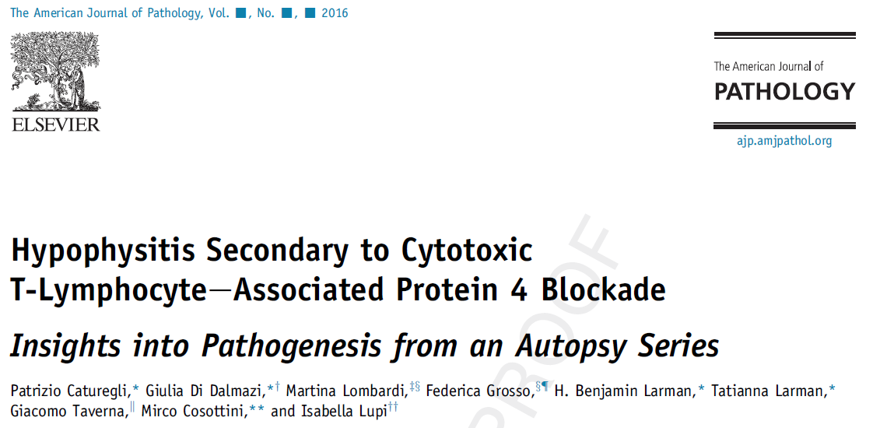
A total of 1005 patients with primary hypophysitis have been described in publications from 1917 to June 2016 , diagnosed by surgical pathology [631 (63%)], clinical and imaging criteria [331 (33%)], or autopsy [43 (4%)].
127 patients with ICIHy have been described in publications as individual case reports or case series

Slide 46
Mass effects:
The most common presenting features
headaches, and visual disturbances
ranging from 24% to 83% of patients with PHy
Headache is the most common mass effect symptom, which is usually generalized and can often be severe
Visual symptoms : visual field defects ,bitemporal hemianopsia, or pupillary defects or diplopia , orbital pain
facial paraesthesia from compression of the branches of trigeminal nerve
Best Practice & Research Clinical Endocrinology & Metabolism YBEEM 2019.101371

Slide 47
Hypopituitarism:
The frequency of AHy-related anterior hypopituitarism reported in the literature ranges from 40% to 81%
The usual sequence of hormonal deficiencies seen with other causes of panhypopituitarism is loss of GH, followed by LH/FSH, TSH, and ACTH
In contrast, in hypophysitis, ACTH deficiency is the most frequently observed deficiency, followed by LH/FSH and TSH deficiencies, and then less frequently GH and prolactin deficiencies
When compared with PHy, the frequency of ACTH, TSH, and LH/FSH deficiencies at diagnosis seem to be more profound in cases of SHy due to ICIHy

Slide 48
A variety of symptoms can manifest based on the type of hormonal deficiency:
fatigue and muscle weakness (ACTH, TSH, FSH, LH, GH),
orthostatic hypotension, anorexia and nausea/vomiting (ACTH),
hyponatraemia (ACTH, TSH),
menstrual irregularities/amenorrhea , erectile dysfunction , hot flashes and vaginal dryness (FSH, LH)
constipation and weight gain ,cold intolerance (TSH) .
Best Practice & Research Clinical Endocrinology & Metabolism YBEEM 2019.101371

Slide 49
Central DI:
in cases of infundibuloneurohypophysitis or panhypophysitis
Sellar germinomas can mimic LINHy, and can also present with a triad of DI, hypopituitarism mainly as GH deficiency, and visual symptoms.

Slide 50
AGENDA:
Introduction
Classification of hypophysitis
Novel causes of secondary hypophysitis
Clinical features of hypophysitis
Diagnosis of hypophysitis
Treatment of hypophysitis
Summary: Challenges and Future directions
Practice Points

Slide 51
Diagnosis of hypophysitis
Biochemical evaluation
Imaging evaluation
Evaluation of secondary causes of AHy
Best Practice & Research Clinical Endocrinology & Metabolism YBEEM 2019.101371

Slide 52
Biochemical evaluation:
Measurement of plasma ACTH, TSH, LH, FSH, GH, PRL, plasma cortisol, free thyroxine, testosterone/ oestradiol, and IGF1.
Central adrenal insufficiency :
A morning cortisol level of <3 mcg/dL is indicative of AI while a level of >15 mcg/dL likely excludes AI .
An ACTH stimulation test must be performed for AM cortisol values between 3 and 15 mcg/dL, and a value of <18.2 mcg/dL at 30 or 60 minutes after ACTH stimulation is suggestive of AI
It is important to note that the ACTH stimulation test was not designed for evaluation of secondary AI . Both the high- and low-dose ACTH stimulation test have similar diagnostic accuracy and are adequate to rule in, but not rule out, central AI . In particular, ACTH stimulation tests can miss cases of secondary AI that have developed acutely.
The gold standard test for evaluating central AI is the insulin tolerance test, which is rarely used given its inherent risks .

Slide 53
In secondary hypothyroidism, the free thyroxine is low and the TSH can be low, normal, or slightly elevated.
For males, along with LH and FSH, an AM serum testosterone (before 10 AM preferably after an overnight fast) should be measured, and a low AM serum testosterone along with low or normal gonadotropins indicates central hypogonadism.
In pre-menopausal women, normal menstruation suggests a normally functioning gonadotroph axis, and central hypogonadism can manifest with menstrual irregularities or amenorrhea. In cases of menstrual irregularities, LH, FSH and serum oestradiol must be measured, and pregnancy must be ruled out in patients with amenorrhea .
In post-menopausal women,absence of elevated LH, FSH is indicative of hypogonadotropic hypogonadism.

Slide 54
GH deficiency is difficult to diagnose with isolated GH or IGF-1 levels due to heterogeneous pulsatility in GH secretion and several confounding factors, including body weight and age, and up to 20% of adults with GH deficiency can have normal IGF-1 levels .
A diagnosis of GH deficiency can be firmly established only through GH stimulation testing .
Prolactin levels must be measured to evaluate for prolactin deficiency and hyperprolactinaemia, both of which can occur with hypophysitis
Central DI must be evaluated in patients with polyuria (defined as >50 ml/Kg/24 hours in adults) .
Immunoglobulin levels must be measured if IgG4Hy is suspected

Slide 55
Imaging evaluation:
MRI is the best imaging modality for diagnosing hypophysitis.
pituitary enlargement
homogeneous pituitary contrast enhancement
pituitary stalk thickening (>4 mm antero posterior diameter on sagittal section)
loss of posterior pituitary bright spot
intrasellar plus suprasellar extension
Best Practice & Research Clinical Endocrinology & Metabolism YBEEM 2019.101371

Slide 56
Figure 4: MRI Findings in a Case of Primary Hypophysitis.
A) T1-weighted image, sagittal section.
B) T1-weighted image, coronal section.
C) T1-weighted image post-gadolinium, sagittal section.
D) T1-weighted image post-gadolinium, coronal section.
A homogeneous enlargement of the pituitary with thickening of the stalk can be seen.
The mass shows intense and homogeneous enhancement post-gadolinium.
Best Practice & Research Clinical Endocrinology & Metabolism YBEEM 2019.101371

Slide 57
Figure 5:
A: Initial MRI of acute hypophysitis in a lady presenting at 6-weeks post-partum with severe headaches, nausea, vomiting, and lactation failure without diabetes insipidus.
MRI shows an enlarged pituitary gland along with thickened stalk. The post-contrast images demonstrate a homogeneous uptake within the pituitary gland.
B: Follow-up MRI 2 months after initiation of
glucocorticoid therapy ,There is evidence of reduction in the pituitary enlargement and stalk thickening.
C: Follow-up MRI 17 months after the initial MRI. There is resolution of all the features of acute hypophysitis.

Slide 58
Other rarer radiographic findings include:
parasellar extension, cystic changes, central necrosis/apoplexy, the presence of a ‘dural tail’ or a ‘meningeal tail’ (contrast-enhanced inflamed tissue along the dura mater), or an empty sella during late stages of the disease
Best Practice & Research Clinical Endocrinology & Metabolism YBEEM 2019.101371

Slide 59
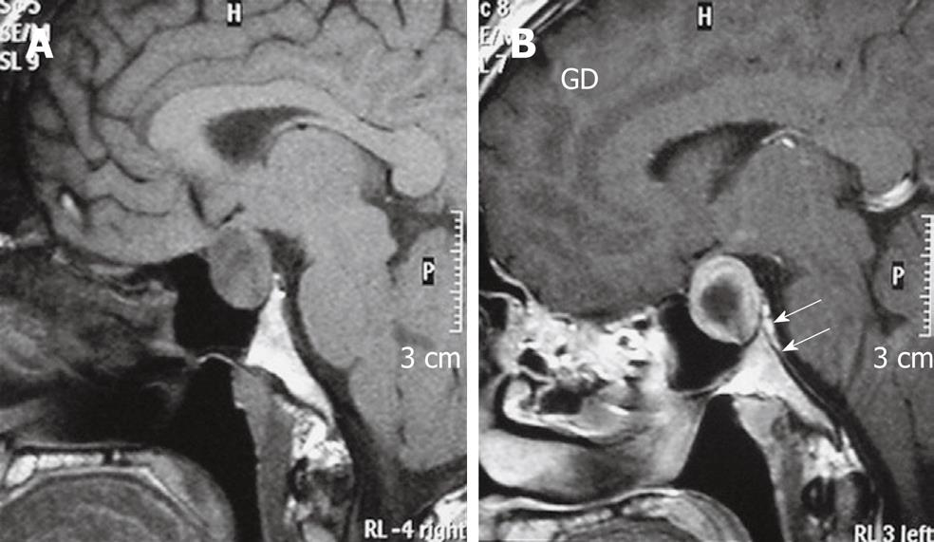

Slide 60
The main challenge in diagnosing hypophysitis on MRI lies in differentiating hypophysitis from a pituitary adenoma.
The following features favored a diagnosis of hypophysitis over an adenoma:
1) Onset during late pregnancy and the early post-partum period
2) Relatively homogeneous uptake of gadolinium contrast and higher enhancement post contrast
3) Absence of the posterior pituitary ‘bright spot’
4) Pituitary stalk thickening

Slide 61
On the other hand:
larger pituitary volume
asymmetric expansion of the pituitary
sphenoid sinus mucosal thickening favors a diagnosis of pituitary adenoma
Best Practice & Research Clinical Endocrinology & Metabolism YBEEM 2019.101371

Slide 62
A. Falorni et al. / Autoimmunity Reviews (2014)

Slide 63
There are some exceptions to these criteria.
A homogeneous intensity can be observed in macroadenomas that are secondarily inflamed,
Cystic areas can occasionally develop in the pituitary, especially in XGHy, and can lead to heterogeneous enhancement
The presence of the ‘bright spot’ is subject to physiologic variations and can be absent in 8% to 25% of individuals, and in up to 29% among elderly subjects, and therefore cannot be used as a sole measure of hypophysitis and/or posterior pituitary damage

Slide 64
Pituitary biopsy :
The gold standard for establishing the diagnosis of Ahy
The procedure is invasive, is not routinely performed
Pituitary biopsy should be undertaken only in select cases where the diagnosis is uncertain and if the results of the biopsy are likely to change the course of management
Best Practice & Research Clinical Endocrinology & Metabolism YBEEM 2019.101371

Slide 65
Some of the physiologic pituitary changes that can mimic hypophysitis:
pituitary hypertrophy in children and during puberty, and pregnancy.
Sheehan’s syndrome
Isolated thyrotroph hyperplasia from severe, long-standing primary hypothyroidism
Best Practice & Research Clinical Endocrinology & Metabolism YBEEM 2019.101371

Slide 66
AGENDA:
Introduction
Classification of hypophysitis
Novel causes of secondary hypophysitis
Clinical features of hypophysitis
Diagnosis of hypophysitis
Treatment of hypophysitis
Summary: Challenges and Future directions
Practice Points

Slide 67
Treatment of hypophysitis
The therapeutic strategies :employed for hypophysitis addresses one or both of the following issues:
1) Treatment of hormonal abnormalities
2) Alleviation of neurological and mass effects

Slide 68
AI is treated with hydrocortisone 15 to 20 mg
Central hypothyroidism is treated with levothyroxine and the biochemical follow-up should be via measurement of free thyroxine levels, with a goal level of mid to upper half of the reference range
Testosterone replacement is necessary for male patients with central hypogonadism in order to improve bone mineral density, libido, sexual function, maintenance of muscle mass, strength, and prevention of anaemia

Slide 69
In premenopausal women with central hypogonadism, hormone replacement therapy should be provided (combined oestrogen – progestin formulations for women with intact uterus and oestrogen-only formulations for those who have undergone hysterectomy) .
GH replacement could be considered in patients with proven GH deficiency, with a starting dose of 0.2 – 0.4 mg/day in patients <60 years of age and 0.1-0.2 mg/day in patients >60 years of age .
Central DI can be treated with desmopressin, but in some instances, partial DI might not bother the patient much and no treatment may be necessary .
Symptomatic hyperprolactinaemia is treated with dopamine agonists (cabergoline, bromocriptine) and the dosage adjusted based on serum prolactin levels .

Slide 70
Immunosuppressive therapy:
for patients with rapid onset of neurological symptoms and mass effects due to pituitary enlargement.
Immunosuppressive drugs have demonstrated efficacy in reducing pituitary swelling, and with restoring pituitary function.
Glucocorticoids :
first-line immunosuppressive agents
as monotherapy or in combination with other immunosuppressive agents
Glucocorticoid therapy is less effective in GHy and XHy .

Slide 71
J Clin Endocrinol Metab, October 2018, 103(10):3877–3889
Objective: To evaluate hypophysitis and pituitary function outcomes
Design: A prospective, double-arm study with a 2-year follow-up, Referral center for pituitary disease
Patients: 20 PAH cases
Interventions: Oral prednisone 50 mg/d or conservative strategy by observation
Main Outcome Measures: Primary endpoint was the improvement/stabilization/worsening of PAH from baseline to a 2-year visit

Slide 72
Figure 1.
Two patients aged .60 y were affected by congestive heart failure as a result of arterial systemic hypertension, without signs and symptoms of PAH-related ophthalmological/neurologic involvement. §
A single patient was
affected by isolated and slight hyperprolactinemia with a previous history of peptic ulcer
disease and was conservatively managed after a cost-benefit analysis.
J Clin Endocrinol Metab, October 2018, 103(10):3877–3889

Slide 73
Observing the group of patients who underwent the immunosuppressive treatment, secondary hypogonadism recovered in all patients, GHD in 2 patients,secondary hypoadrenalism and hyperprolactinemia in 1 patient, and diabetes insipidus improved in 3 cases. Worsening of the pituitary function did not occur in any of these patients.
Among the patients not treated with immunosuppressive drugs, hyperprolactinemia recovered in a single patient, and secondary hypogonadism improved in another one
Worsening of pituitary function resulted in 3 patients, with the occurrence of secondary hypoadrenalism in all cases and of secondary hypothyroidism in one case.

Slide 74
J Clin Endocrinol Metab, October 2018, 103(10):3877–3889
Histogram representing patients’ endocrine outcome according to treatment choice.
Bars indicated patients’ outcome. Fisher test proved a statistically significant high frequency of worsening of pituitary function among conservatively managed patients compared with immunosuppressive-treated ones (*P = 0.04).
Endocrine outcome is correlated to the treatment choice: improvement/recovery of pituitary function occurred more frequently in immunosuppressive-treated patients compared with untreated ones (respectively, 58.3% vs 25%; P = 0.04),

Slide 75
the improvement of pituitary function during follow-up is predicted by APA, secondary hypogonadism, diabetes insipidus, pituitary volume lower than 493 ,pituitary stalk at optical chiasm larger than 3.9 mm, and absence of the physiological posterior pituitary bright spot on T1w MRIs.

Slide 76
Objective: To identify clinical and radiological findings associated with response to glucocorticoids.
Design and methods: 12 consecutive patients with AH, evaluated from 2008 to 2016. Mean follow-up time was 30 ± 27 months (range 12–96 months).
European Journal of Endocrinology
(2017) 177, 127–135

Slide 77
Table 1 Clinical, radiological and pathological features of patient population at diagnosis.
MRI identified two main patterns of presentation: global enlargement of the pituitary gland or panhypophysitis (n = 4, PH), and pituitary stalk abnormality only, or infundibulo-neuro-hypophysitis (n = 8, INH).
Multiple tropin defects were more common in PH (100%) than those in INH (28% P = 0.014), whereas diabetes insipidus was more common in INH (100%) than that in PH (50%; P = 0.028).

Slide 78
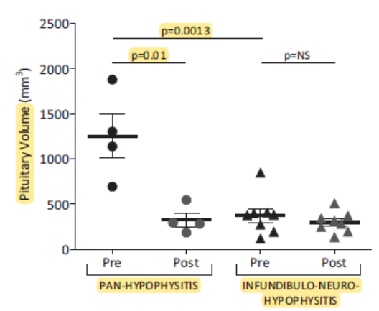
Panel A:
Mean pituitary volume at diagnosis was larger in PH (1253 ± 489 mm3) than that in INH (374 ± 218, P = 0.0013)
European Journal of Endocrinology
(2017) 177, 127–135

Slide 79
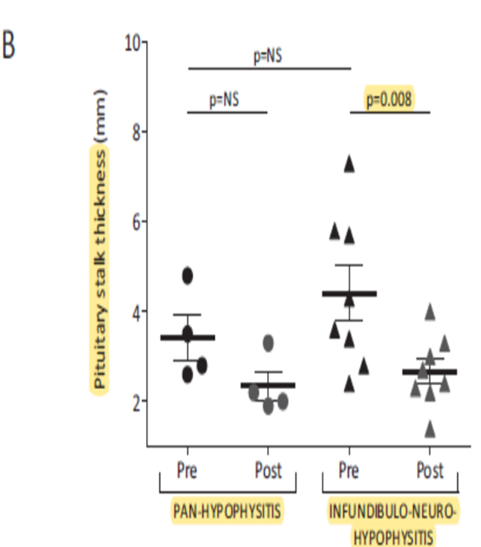
Panel B:
mean stalk diameter did not differ (PH 3.42 ± 0.99 mm, INH 4.4 ± 1.7 mm, P = 0.31
European Journal of Endocrinology
(2017) 177, 127–135

Slide 80
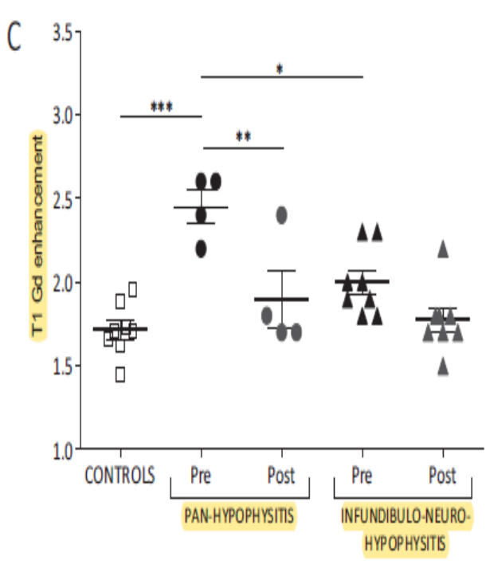
Panel C:
mean T1 signal after gadolinium was significantly higher in PH than that in controls
(2.45 ± 0.19 and 1.71 ± 0.15 respectively, P < 0.001) and
in PH than that in INH
(2.0 ± 0.2, P < 0.05), but
did not differ between INH and controls.
European Journal of Endocrinology
(2017) 177, 127–135

Slide 81
Hormonal defects of patients present at diagnosis and at the end of follow-up.
White open boxes: Normal; Solid black boxes: Deficiency
All 4 PH and 4 out of 8 INH were treated with glucocorticoids. defective anterior pituitary function recovered only in the two patients without diabetes insipidus (50%) and panhypopituitarism persisted, along with diabetes insipidus, in the remaining 2 (50%).
In all INH patients, either treated or untreated, diabetes insipidus persisted in all.
European Journal of Endocrinology
(2017) 177, 127–135

Slide 82
Anterior pituitary function can spontaneously improve in up to 33% of patients, although the rate of recovery is highly variable.
Glucocorticoid treatment has also shown somewhat similar rates in improvement in anterior pituitary function (12% to 41%) .
Cortisol and gonadotroph axes tend to improve more frequently with therapy
Glucocorticoid therapy may improve anterior pituitary function in a subset of patients but has no effect on restoring posterior pituitary function.
DI rarely recovers is more often refractory. DI has been shown to be a negative prognostic factor in the response of AHy to glucocorticoid therapy

Slide 83
METHODS: In total, 98 patients with melanoma who had ipilimumab-induced hypophysitis were identified retrospectively in the Partners Healthcare system using an automated electronic medical record query tool.
Patients with melanoma who received ipilimumab at Massachusetts General Hospital
without developing hypophysitis were listed in an actively maintained institutional patient database.
Glucocorticoid doses for patients with hypophysitis were categorized as low dose (LD <7.5 mg prednisone ) or high dose (HD>7.5 mg). Survival analyses were performed for patients who received ipilimumab monotherapy.
American Cancer Society.2018

Slide 84
American Cancer Society.2018

Slide 85
Both overall survival A (OS) and (B) the time to treatment failure were significantly longer in the LD group compared with the HD group (hazard ratio, 0.24; P5.002 and 0.28, P5.001, respectively). Median OS and the time to treatment failure were not reached in the LD group and were 23.3 and 14.5 months, respectively, in the HD group.
Cancer Month 00, 2018 1

Slide 86
All patients who had hypophysitis had improved OS compared with patients who did not have hypophysitis (median, 28.2 vs 9.5 months; P5.0003).
Cancer Month 00, 2018 1

Slide 87
There is concern of reduced survival among patients who receive glucocorticoids for ICIHy based on a study in a melanoma cohort receiving ipilimumab . But even those patients who received glucocorticoids for ICIHy had a better overall survival compared to patients who did not develop ICIHy.
Nevertheless, high dose glucocorticoids are not recommended for ICIHy except for acute presentations such as symptomatic mass effects .
Best Practice & Research Clinical Endocrinology & Metabolism YBEEM 2019.101371

Slide 88
In contrast to PHy, ICIHy appears to be more refractory to glucocorticoid therapy, and studies have demonstrated the lack of improvement or recovery of hormonal function of pituitary function even after 12 months of glucocorticoid treatment .
Best Practice & Research Clinical Endocrinology & Metabolism YBEEM 2019.101371

Slide 89
glucocorticoid therapy is recommended in ICIHy based on the severity:
grade | Adverse event severity | recommendation
grade 1 | asymptomatic | hormone replacement can be provided and there is no need for discontinuation of ICI therapy
grade 2 | mildly symptomatic | hormone replacement can be provided and there is no need for discontinuation of ICI therapy
grade 3 | moderately symptomatic | ICI therapy must be delayed and re-initiation of ICI must be considered based on clinical response to hormonal replacement/ glucocorticoid treatment
grade 4 | severe or life-threatening | ICI therapy must be discontinued and high dose glucocorticoid therapy must be administered

Slide 90
Other immunosuppressive agents such as azathioprine, methotrexate, and cyclosporine A can be used in patients who relapse or do not respond to glucocorticoid therapy, and these modalities have been shown to be effective in both PHy and SHy .
Rituximab can be of potential benefit, especially among those patients with IgG4Hy or those with a biopsy-proven B lymphocyte predominant, steroid-refractory hypophysitis .
Best Practice & Research Clinical Endocrinology & Metabolism YBEEM 2019.101371

Slide 91
Surgery
- Uncertain diagnosis
- Rapid progression of neurological symptoms
- Large space-occupying lesions/accessible through transsphenoidal approach
An advantage of surgery is that it allows for conclusive histopathological diagnosis and can definitively reduce mass-effects from AHy
Surgery could be a better option for GHy, where it has shown better resolution of symptoms, lesser need for hormone replacement, and lower rates of recurrence when compared to glucocorticoid treatment .
Best Practice & Research Clinical Endocrinology & Metabolism YBEEM 2019.101371

Slide 92
stereotactic radiotherapy
In cases that are refractory to both medical and surgical modalities
Best Practice & Research Clinical Endocrinology & Metabolism YBEEM 2019.101371

Slide 95
AGENDA:
Introduction
Classification of hypophysitis
Novel causes of secondary hypophysitis
Clinical features of hypophysitis
Diagnosis of hypophysitis
Treatment of hypophysitis
Summary: Challenges and Future directions
Practice Points

Slide 96
Summary: Challenges and Future directions
A substantial wealth of knowledge has acclimated over the past decade on the pathophysiology, diagnostic approach, and treatment strategies for management of hypophysitis and pituitary autoimmune conditions.
The precise classification of hypophysitis is still a matter of debate.
Some publications include all the autoimmune forms of hypophysitis such as those associated with vasculitis or APS under PHy , while others have classified hypophysitis from systemic autoimmune disease under SHy .
On the other hand, some forms of PHy such as IgG4Hy (which have multi-organ involvement) are placed under both PHy and SHy .

Slide 97
Therefore, further research into molecular and histopathological demarcation between the various forms of hypophysitis is necessary for a more precise classification of the condition.
Future investigations on the role of autoantibodies and HLA phenotypes in the pathogenesis of AHy could provide more insights into the relationship between the pituitary gland and the immune system.

Slide 98
AGENDA:
Introduction
Classification of hypophysitis
Novel causes of secondary hypophysitis
Clinical features of hypophysitis
Diagnosis of hypophysitis
Treatment of hypophysitis
Summary: Challenges and Future directions
Practice Points

Slide 99
Practice Points
Hypophysitis is a heterogeneous condition that leads to inflammation of the sella and/or suprasellar region, potentially resulting in hormonal deficiencies and/or mass effects
A preponderance of hypophysitis subtypes have an underlying autoimmune aetiology
The overall incidence and prevalence of hypophysitis has dramatically increased over the past decade, with a rise in the occurrence of certain forms of hypophysitis such as IgG4 hypophysitis (IgG4Hy) and immune checkpoint inhibitor induced hypophysitis (ICIHy)

Slide 100
The clinical presentation varies from an asymptomatic condition to a fatal disease
Milder forms of hypophysitis are treated with replacement of deficient hormones
more acute presentations with mass effects require glucocorticoid therapy ,immunosuppressive therapy or surgery
MRI is the best imaging modality for diagnosing hypophysitis
Glucocorticoids are the first-line immunosuppressive agents for the treatment of Ahy
Surgery should be reserved for cases of uncertain diagnosis, rapid progression of neurological symptoms, and large space-occupying lesions that are accessible through transsphenoidal approach
71% to 72% of patients require long-term hormone replacement therapy

Slide 101


